Slide 1
Brook in Barnet

Slide 2
About Brook
Brook is the UK’s leading sexual health and wellbeing charity for young people We provide free and confidential relationships and sexual health services to under 25s throughout the UK and Jersey We also provide counselling & wellbeing services, sex & relationships education and training for professionals

Slide 3
Brook Education
Brook believes that it is every young person’s right to access good quality education to support the development of positive sexual and emotional health, relationships and wellbeing

Slide 4
Our offer in Barnet (RSE for 13-25 year olds)
Young Health Champions
Professional Training
My Life
Targeted Outreach in Community Settings
RSE in Schools

Slide 5
Education Topics/ RSE Sessions in Schools
Sexual Health and Wellbeing
Yr 9-13 Contraception
Yr 9-13 STIs
Yr 9-13 Pornography
Yr 9-13 Intro to Sexual Health
Yr 10-13 Periods and Wellbeing
Yr 10-13 Pleasure
Yr 10-13 Pregnancy Choices (Abortion)
Yr 10-13 HPV
Yr 12-13 Erection Problems
Healthy Relationships and Abuse
Yr 7-13 Healthy Relationships
Yr 12-13 Relationship Abuse
Yr 9 Understanding and Challenging Gender Stereotypes and Misogyny
Yr 7-13 FGM
Yr 10 – 13 Understanding & Responding to Sexual Harassment
LBGTQ+
Yr 7-13 Gender and Stereotypes
Yr 7-13 Gender Identity and Stereotypes
Yr 7-13 Sexual Orientation and Stereotypes
Yr 7-13 LGBTQ+ Identities
Yr 12-13 Transphobia, Challenging Prejudice and Allyship
Consent
Yr 7 Consent and Social Media
Yr 8 Consent and Boundaries
Yr 9-13 Consent
Yr 9-13 Sex and the Law
Yr 10-13 Sex pressures, risk-taking and readiness for sex
Online Safety
Yr 7-9 Online Safety and Youth Produced Sexual Imagery
Yr 9-13 Youth Produced Sexual Imagery
Yr 10-13 Online Misogyny, Real World Impacts
Notes:
Understanding & responding to sexual harassment - That there are a range of strategies for identifying and managing sexual pressure, including understanding peer pressure, resisting pressure and not pressurising others
Practical steps they can take in a range of different contexts to improve or support respectful relationships
How to get further advice, including how and where to access confidential sexual and reproductive health advice and treatment
What constitutes sexual harassment and sexual violence and why these are always unacceptable
healthy/harmful behaviours in a relationship
•Identify the qualities of healthy relationships and the skills needed to support them
•Describe different types of abuse and the possible effects on the survivors of abuse
•Identify harmful sexual behaviours, including sexual harassment
•Recognise that abuse is always wrong, and that people of all genders can be perpetrators and victims of abuse and sexual violence
•Identify the range of support available for those in abusive situations and the benefits from seeking help

Slide 6
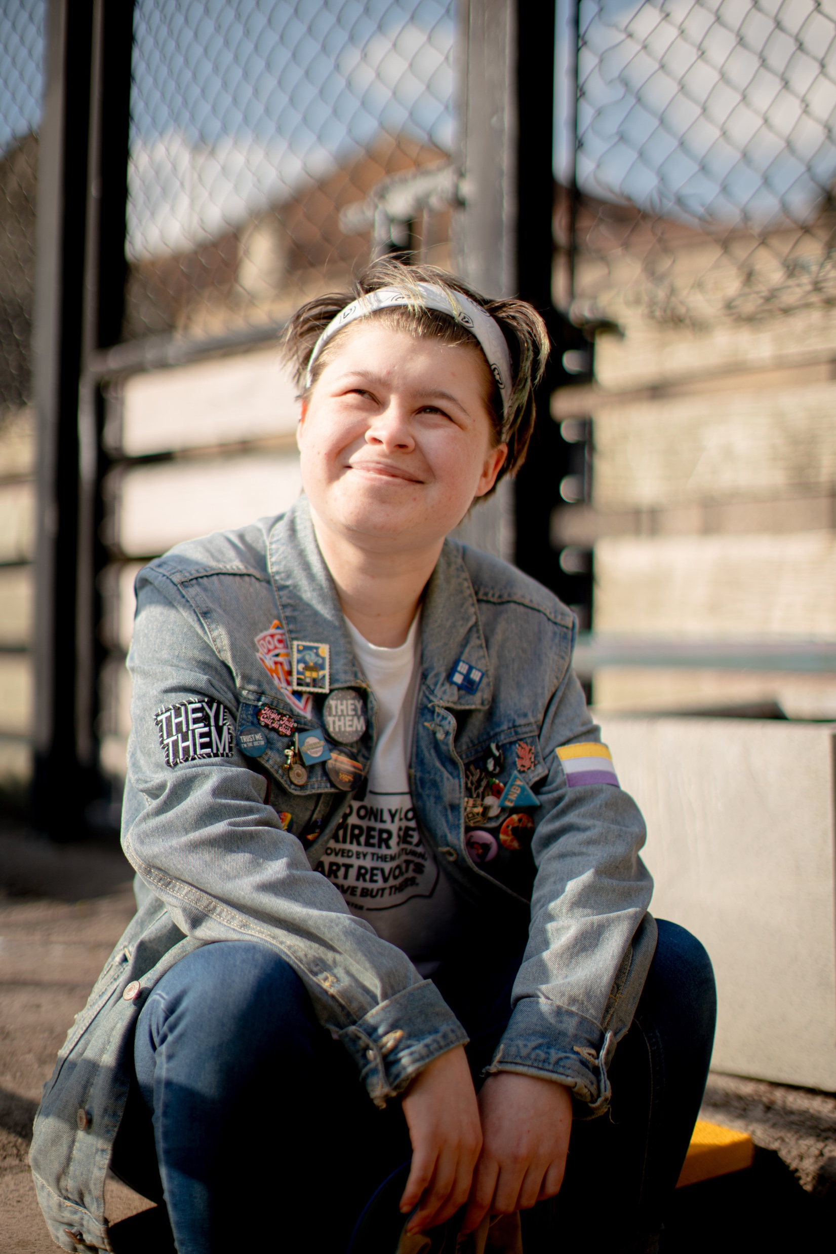
My Life
Brook’s My Life 1:1 programme is an early help intervention.
Combine education on relevant relationships, sexual health and health and wellbeing topics and motivational and coaching activities, all selected from a toolkit of quality-assured resources.
Notes:
Brook’s targeted support is educational rather than therapeutic. It is based on a supported self-help approach that supports children and young people to communicate effectively with others about their experience of relationships and sex.
The sessions are designed to teach young people personally directed behaviour change skills and include the opportunity to practise the skills they have learned with the support of a Brook Specialist. It takes a toolkit approach to the range of resources available, allowing our specialist to create a bespoke programme for each individual young person.
Our 1-1 targeted support is aimed at young people aged 11+ who choose to take part – voluntary engagement is key to the programme.
The structure provides a consistent framework for a programme of one-to-one sessions. Support can be delivered either as part of a fixed number of sessions (minimum of 6) or as part of ongoing support for an individual young person.

Slide 7
Outcomes for my life
Engage young people on a voluntary basis
Based on mutual trust and respect
Start where young people are/what’s important to them
Build on interests and ability to improve own lives, health and wellbeing
Develop and practice lifelong skills around life goals
Explore and identify aspirations for health and wellbeing
Provide needs-led personal, health and economic education on a variety of sexual, mental and general health and wellbeing topics

Slide 8
Professional training
Brook believes that it is essential for all professionals working with young people to receive good quality training to ensure they can support and enable the positive development of young people’s sexual and emotional health, relationships and wellbeing

Slide 9
Training topics
C-Card Training
SHIC: Sexual Health Information The Community
Teaching Consent and Managing Disclosure of Sexual Violence
Supporting & Including LGBT+ Young People
RSE for SEND young people
Managing Difficult Questions and Sensitive Issues in RSE
Pornography (Sex Pressures and Social Networks)

Slide 10
Understanding consent
Notes:
In 2018 a survey with 2,000 young people (14-24) was carried out by the Family Planning Association
Fewer than half of people surveyed (47%) think it's OK for someone to withdraw consent if they are already naked
9% of people don’t think it is OK to withdraw consent under any of the following circumstances: - They have been bought dinner - They have been bought drinks - They have already kissed the other person - They are in a bedroom - They have had sex with that person before

Slide 11
Notes:
Starts before a young person has their first experience of sex
Responds to the needs of young people as they mature.
RSE must start in primary school and be taught in an age-appropriate manner, starting with topics such as personal safety and friendships.
Both primary and secondary school pupils, particularly girls, have said they need RSE to start earlier.

Slide 12
Notes:
Fewer than half of people surveyed (47%) thought it would be OK for someone to withdraw consent if they were already naked.
And 9% (almost 1 in ten) young people didn’t think it would be OK to withdraw consent under any of the following circumstances:
They have been bought dinner
They have been bought drinks
They have already kissed the other person
They are in a bedroom
They have had sex with that person before
Taken from FPA: https://www.fpa.org.uk/news/less-half-people-think-it’s-ok-withdraw-sexual-consent-if-theyre-already-naked

Slide 13
Notes:
Consent topics of conversation begin at primary school, exploring everyday consent, boundaries, rights and responsibilities
Consent – golden thread throughout the key stages; covered in healthy relationships, digital consent, explaining sexual health (contra/STIs/condom use) discussing pleasure, pornography, peer pressure (drugs, alcohol and so on), rights & responsibilities. Not a standalone topic.
Ideas are built on and expanded
Always ensure a meaningful safe space is created at the beginning of any PSHE session

Slide 14
Notes:
https://learning.nspcc.org.uk/child-abuse-and-neglect/peer-on-peer-sexual-abuse – see NSPCC guidance
Peer-on-peer sexual abuse is sexual abuse that happens between children of a similar age or stage of development. It can happen between any number of children, and can affect any age group (Department for Education (DfE), 2018).
Children can experience peer-on-peer sexual abuse in a wide range of settings, including: at school, at home or in someone else's home in public spaces, online
It can take place in spaces which are supervised or unsupervised. Within a school context, for example, peer-on-peer sexual abuse might take place in spaces such as toilets, the playground, corridors and when children are walking home (Contextual Safeguarding Network, 2020).

Slide 15
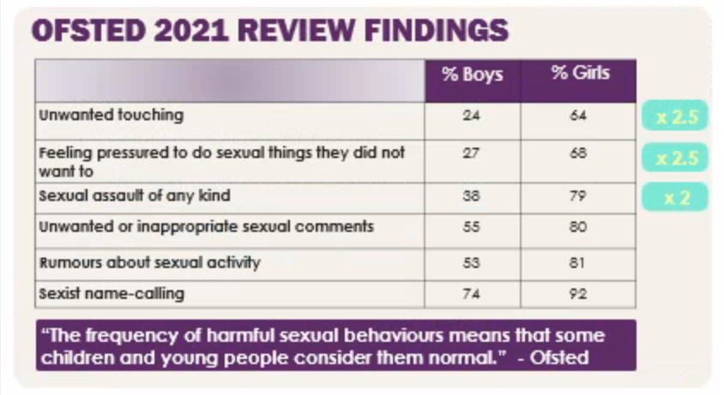
Notes:
Note that the first three harmful behaviours in the chart were up to twice or 2.5 more times likely to affect girls.
The Ofsted Rapid Review conducted interviews with over 900 children and young people and staff in 32 schools and colleges in England. It said that sexual harassment has become "normalised" among school-age children, with nine in 10 girls having experienced sexist name-calling or were sent explicit photos or videos. It also said that more than two-thirds of girls said they endured unwanted touching "a lot" or "sometimes", while eight in 10 said they had been put under pressure to share sexual images of themselves. The report said that students often do not see the point of reporting abuse and many teachers underestimate the scale of these problems.
The report said that sexual abuse and harassment among young people in schools had become normalised. Girls were much more likely to be the victims of abusive behaviours.

Slide 16
Notes:
What the impact of this could be on young people?
What ways can we challenge and educate?
The person who has broken consent, how can they be supported/educated – they are also a child (if peer on peer) and will need support.
Oftsed (June 2021)
In terms of sexualised language, children and young people told us that ‘slag’ and ‘slut’ were commonplace and that homophobic language was also used in school
‘body shaming’ and ‘slut shaming’ common in schools
Children and young people reported boys giving girls marks out of 10 based on their physical appearance while they were travelling to and from school together.
Many felt that staff either were not aware of this language, dismissed it as ‘banter’ or simply were not prepared to tackle it

Slide 18
Notes:
Avoid questions that start with “Why…” or which use directives (“Explain to me…”) or which demand a chronological account (And then want happened next?”). These kinds of questions can create a stress response in a traumatised person.
Open ended questions and requests support people who have been traumatised to retrieve information and offer them more control over their account.

Slide 19
C-Card scheme
A C-Card scheme is a type of condom distribution scheme, providing registered young people with a C-Card – online or credit-card style– which entitles them to free condoms.
Register – you will be assessed to ensure you’re safe, competent to consent and know how to use a condom
Issue – once the c-card is issued, you are entitled to an agreed number of supplies for free from participating distribution points
Review – after receiving supplies, you will return to the registration outlet where sexual health needs are reviewed

Slide 20
C-Card aims
✓ Normalise and promote condom use as part of healthy sexuality and a healthy sexual culture
✓ Give professionals working with young people the chance to talk about sexual and reproductive health, and to promote healthy relationships
✓ Increase the number of young people accessing services.
✓ Provide access for young people who face perceived or actual barriers to services

Slide 21
Young Health Champions
Brook has recently launched an accredited peer education programme to support young people in the borough to be Health Champions.
Level 2 Award in Young Health Champions accredited by The Royal Society of Public Health.
Aimed at young people between the ages of 14 and 25.
4 units:
• Health Improvement
• Research Health Improvement Services
• Deliver a Health Improvement Message
• Understanding Sexual Health

Slide 22
Our offer in Barnet (HIV 18+)
Community Outreach + Pop Up Events
Professional Training
Point of Care Testing & SHL test kits
Community Champions
Notes:
The Barnet Adult Targeted Community HIV prevention service works to raise awareness of HIV and encourage residents aged 18+ to get tested, helping to reduce the rate of late diagnosis.

Slide 23
Outreach in Community Settings
Brook works with community groups and organisations in Barnet to embed outreach and drop-in sessions where our team provides information and advice around HIV awareness and prevention. We also signpost people to appropriate services and distribute resources including educational pamphlets and condoms
C-Card for under 25’s
At-home STI tests
Point of Care Testing
Pop-up events for sexual health awareness days
Offer advice, information and signposting
Refer to local clinics
Education on PrEP, PEP and U=U

Slide 24
Professional Training
We offer free open-access and in-house training for professionals living or working in Barnet.
An introduction to the Barnet HIV prevention service and HIV awareness
HIV risk assessment and prevention
Understanding HIV transmission, testing and treatment
Stigma and changing attitudes around HIV
Working with people living with HIV
PrEP, PEP and U=U
Referrals and signposting

Slide 25
EVERYONE IS SUPPORTED TO LIVE HEALTHY LIVES, FREE FROM INEQUALITY AND STRENGTHENED BY FULFILLING RELATIONSHIPS
Our mission

Slide 26
brook.org.uk

