Slide 1


Slide 2
Barnet Family Services - Child And Family (Early Help)
Early Help Assessment Team
Children’s Centres
Youth Service (Positive Activities, BACE, DofE)
Early Years/childcare
Supported Families’ Consultants (seconded from other agencies)
Linked with Barnet Integrated Clinical (BICs) Service

Slide 3
Working across the whole continuum of need and support
Universal- drop-in services available to all children/young people/families from venues across the Hubs
Universal Plus –for those who may need additional support
/or signposting to other support, but don’t need a co- ordinated multi-agency plan (less than 3 agencies)
Targeted- for those requiring an Early Help Assessment (*EHA) if a multi-agency and coordinated approach is needed to meet their needs (3 agencies or more)
Specialist – We provide range of interventions from our Menu of Intervention as part of a statutory plan to support Children’s Social Care and Youth Justice Service.

Slide 4
What referral do I need to make?
Safeguarding Concern Referral
If you are worried that a child may be suffering, or may be at risk of harm, you should complete a safeguarding concern referral.
Early Help Assessment Referral
When you have a range of needs and it is likely that we may need to work together with other professionals.
Universal Plus Referral
Providing access to a range of parenting programmes and support where working with other professionals is not likely to be required.
Universal
No referral required.

Slide 5
 | Barnet Family Services - Child And Family Offer (Early Help) Menu of Intervention The Early Help (EH) hubs offer a range of services and evidenced based programmes and interventions for children and young people and their families that are focused on early help. The main objectives of the Child And Family hubs are to provide the right help first time; that meets identified need, improves outcomes for children and young people and prevents the escalation of issues that would then require specialist services.
Child and Family
(Early Help)

Slide 6
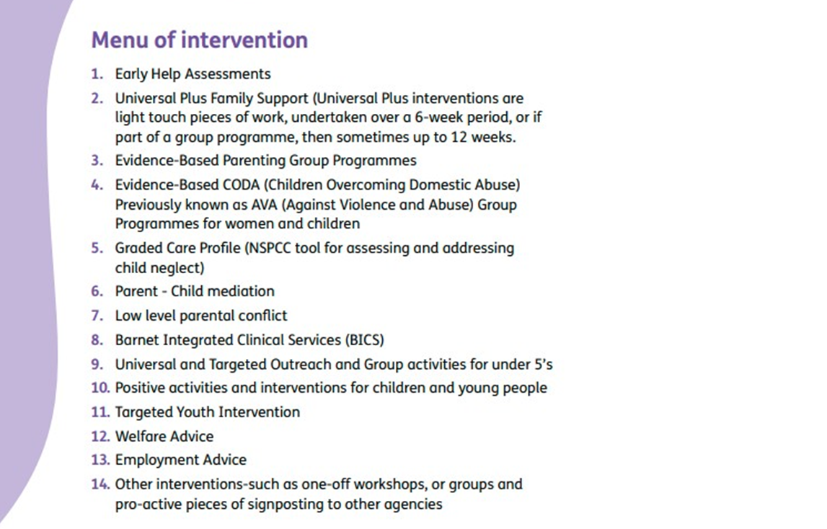

Slide 7
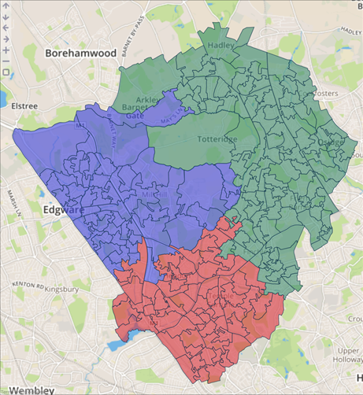

Location of the 3 Hubs
January 2018
West Hub
East /Central Hub
South Hub

Slide 8
East/Central Hub
Covers the postcodes of: N2, parts of N3, parts of N10, N11, N12 parts of N14, EN4 and EN5.
Main Hub office: Newstead Children’s Centre, 1 Fallows Close (off Tarling Road), Finchley, N2 8LG, Telephone: 020 8359 3460.
Michaela.Carlowe@barnet.gov.uk
West Hub
Covers the postcodes of: HA8, part of NW7, part of NW9
Main Hub office:
Barnet and Southgate College- Colindale, 7 Bristol Avenue (formerly Lanacre Avenue) London NW9 4BR, Telephone 020 8359 3510
Andrea.mullings@barnet.gov.uk
South Hub
Covers the postcodes of: part of NW2, NW3, part of NW4, part of NW11, part of NW9, part of N3
Main Hub office: Parkfield Children’s Centre, 44 Park Road, Hendon, NW4 3PS, Telephone: 020 8359 3590
Meera.Bhayani@barnet.gov.uk

Slide 9
Other contacts
Karen Pearson – Head of Service
Debra Davies – Assistant Head of Service
Andy Whiting – Early Years and Primary Lead
Laura Davitt – Team Manager Positive Activities, BACE
Ramona Burke – Duke of Edinburgh Programme

Slide 10


BACE Holidays
Winter BACE Magazine – Partnership work with Better Gyms, BMX providers, Bread N Butter to create recipes, Cost of Living tips and advice, sign posting and much more.
BACE Video with a provider and the feedback of why children and young people like to attend BACE Holidays

Slide 11

Time to Explore…..
https://www.barnet.gov.uk/children-and-families/early-help- children-young-people-and-families
Barnet Children’s Centres
https://www.barnet.gov.uk/childrencentres

Slide 12
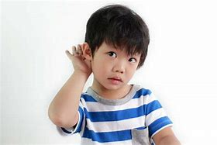


Voice of the Child – Video
EH - LISTENING TO YOUNG PEOPLE

