Slide 1
Safeguarding in Schools
Liam Foote – School Safeguarding Lead

Slide 2
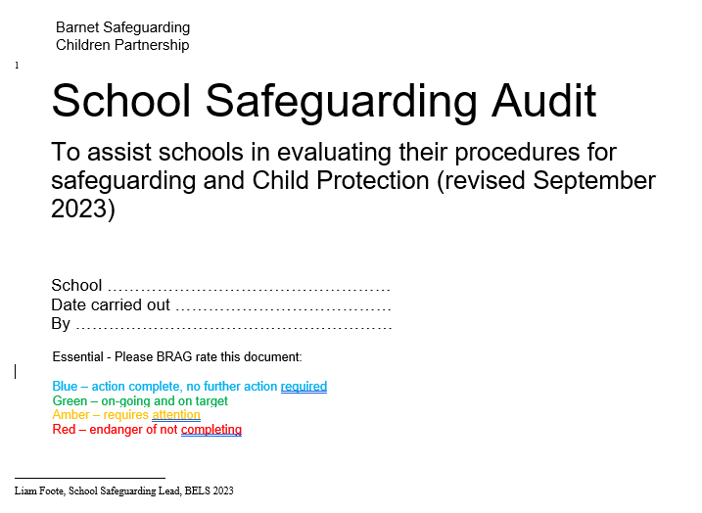
Reviewing procedures and practice

Slide 3
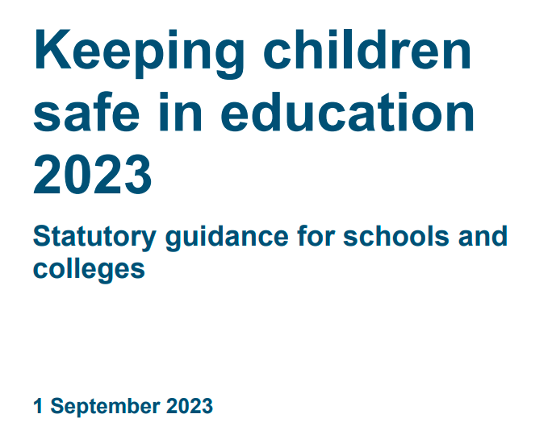
Responding to Incidents

Slide 4
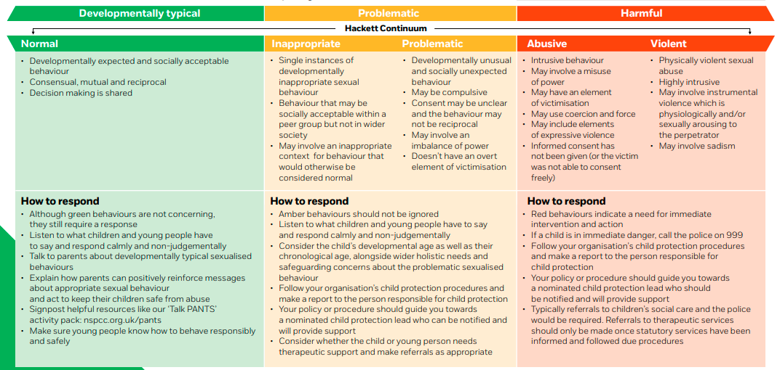
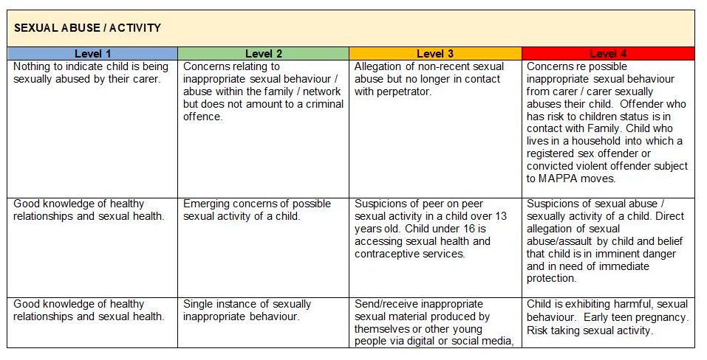
Understanding sexualised behaviour in children | NSPCC Learning
The Barnet Safeguarding Children Partnership - (thebarnetscp.org.uk)

Slide 5
Risk Assessment
The risk and needs assessment for a report of sexual violence should consider:
The incident details
The victim, especially their protection and support
Whether there may have been other victims
The alleged perpetrator(s)
All the other children, (and, if appropriate, adult students and staff) at the school or college, especially any actions that are appropriate to protect them from the alleged perpetrator(s), or from future harms, and
The time and location of the incident, and any action required to make the location safer.
Risk Assessment Templates
Identifying sexualised behaviour questions
Understanding sexualised behaviour in children | NSPCC Learning

Slide 6
Victims wishes
Nature of the incident
The age and developmental stages of children
Power imbalances or vulnerabilities
Considerations
On-going risks
Intra familial hams
Extra familial harms

Slide 7
Managing Internally
Actions
Early Help
The school or college may take the view that the children concerned are not in need of early help or that referrals to statutory services are not required, and that it would be appropriate to handle the incident internally, perhaps through utilising their behaviour policy and by providing pastoral support.
Early help can be particularly useful to address non-violent HSB and may prevent escalation of sexual violence. It is particularly important that the designated safeguarding lead (and their deputies) know what the local early help process is and how and where to access support.

Slide 8
Referral to Social Care
Call MASH for advice
Police
Schools and colleges should not wait for the outcome (or even the start) of a police investigation before protecting the victim, alleged perpetrator(s), and other children in the school or college.
Where a child has been harmed, is at risk of harm, or is in immediate danger, schools and colleges should make a referral to local authority children’s social care.
Inform parents
If a report of rape, assault by penetration, or sexual assault is made, the starting point is that this should be passed on to the police. Whilst the age of criminal responsibility is ten, if the alleged perpetrator(s) is under ten, the starting principle of reporting to the police remains. when-to-call-the-police--guidance-for-schools-and-colleges.pdf (npcc.police.uk)

Slide 9
Ongoing support
Supporting the
victim
Supporting the perpetrator
The fact that another body is investigating or has investigated an incident does not in itself prevent a school from coming to its own conclusion, on the balance of probabilities, about what happened, and imposing a penalty accordingly.
Paragraph 532-541 KCSIE
Paragraph 542-547 KCSIE

Slide 10
Supporting witnesses
Ongoing bullying in school
Reviewing policies and procedures
Safeguarding other children
Online harassment – pages 110-111 KCSIE
Whole school approach

