Slide 1
SACRE Agreed Syllabus Curriculum Focus
Jan McGuire
Religious Education Adviser
March 2020

Slide 2
Curriculum Planning
Agreed Syllabus: Making it user friendly
Sequential
Scaffolding
Rigour: Etymology
Planning: building on prior learning
Being able to tell the story of progression

Slide 3
What exactly do we mean by curriculum?
To help here, (Ofsted) came up with a working definition, which states
that curriculum is… (Sean Harford: based on October 2019 review)
A framework for setting out the aims of a programme of education,
including the knowledge and understanding to be gained at
each stage (intent)…
…for translating that framework over time into a structure and narrative,
within an institutional context (implementation)…
…and for evaluating what knowledge and understanding pupils have
gained against expectations (impact).

Slide 4
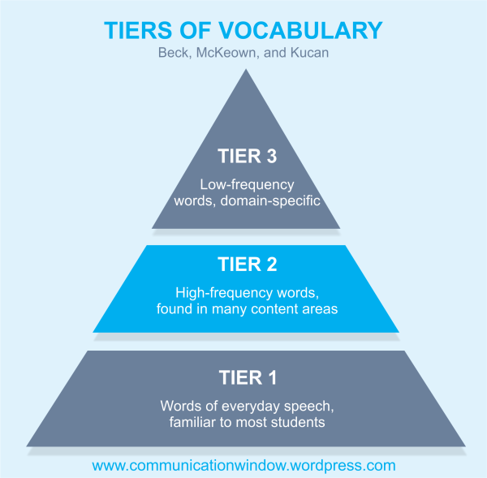

Slide 7
SACRE : Tier 3 Word List: Sikhism
Word | Meaning/ Definition

Slide 8
SACRE : Tier 3 Word List: Judaism
Word | Meaning/ Definition

Slide 9
SACRE : Tier 3 Word List: Christianity
Word | Meaning/ Definition

Slide 10
SACRE : Tier 3 Word List: Islam
Word | Meaning/ Definition

Slide 11
SACRE : Tier 3 Word List: Hinduism
Word | Meaning/ Definition

Slide 12
SACRE : Tier 3 Word List: Humanism
Word | Meaning/ Definition

Slide 13
SACRE : Tier 3 Word List: Buddhism
Word | Meaning/ Definition

Slide 14
SACRE : Tier 3 Word List: Name of Religion/ World View:
Word | Meaning/ Definition

Slide 15
SACRE : Tier 3 Word List: Name of Religion/ World View:
Word | Meaning/ Definition

Slide 16
Foundation | KS1 | KS2 | KS3 | KS4 | Sixth Form RE
Myself Belonging | Special places in the home and the community | Religion and the individual Religion, family and the community (places of worship) Pilgrimage and sacred places) | Interfaith dialogue Global issues Religion and Science | To follow Religious Education Examination specifications provided by one of the awarding bodies | Contemporary issues for religion: Diversity and Equality The individual and personal quest for meaning Ethics and relationships Social and Environmental Responsibility
 | Story Celebration Symbols | Teaching and Authority (sacred texts) Worship Journey of life and death Symbols and religious expression | Authority Beliefs and concepts Expressions of spirituality | To follow Religious Education Examination specifications provided by one of the awarding bodies | Aspects of religion and: Psychology Science Arts
 | Leaders and teachers Beliefs Believing | Inspirational people Beliefs Beliefs in action | Ethics and relationships Rights and responsibilities and coming of age | To follow Religious Education Examination specifications provided by one of the awarding bodies | Philosophy of religion

